Slide 1
ENEL 419 PROBABILITY AND RANDOM VARIABLES
1 FOUNDATIONS OF PROBABILITY
(Reading Exercises: Montgomery and Runger Chapter 1 -Sections 2.1, 2.3 and 2.4)

Slide 2
Textbooks
Required:
(EBK) APPLIED STATISTICS AND PROBABILITY FOR ENGINEERS+B176 7E (9781119400363) or (PKG) APPLIED STATISTICS AND PROBABILITY for ENGINEERS LL 7E W/ EPUB REG CARD (9781119456261) or Wiley plus
Recommend:
Probability and Stochastic Processes: A friendly introduction for electrical and computer engineers, 3rd Edition. R. D. Yates and D. J. Goodman, Wiley, 2014
Students’ solution manual (odd numbered problems) at Author’s website: http://www.winlab.rutgers.edu/~ryates/student3e/studentsolns3.pdf

Slide 3
Overall Course Objectives
• Introduce students to the logic of probability theory.
• Develop intuition into how the theory of probability relates to practical situations and works with practical problems.
• Apply probability theory and statistics to solve electrical engineering problems.

Slide 4
Important Notes
Throughout this course, we'll be learning all about
The basics of probability - its properties, and how to calculate a probabilities.
The basics of statistics – their properties, how they are obtained and how inferences are made about a population of interest.
Make sure that you understand all the steps in the proofs and the derivations.
You do not have to remember all the proofs. you only need to the proofs.
Make sure that you understand all the important concepts.
If you have difficulty understanding the concepts, you need instructor’s help.
If you cannot understand the concepts, you will have difficulty understanding and
solving problems.

Slide 5
Applications
Computer Science | Electrical Engineering | General
Machine Learning Data Mining Simulation Image Processing Computer Vision Computer Graphics Visualization Software Testing Analysis of Algorithms Etc. | Signal Processing Telecommunications Information Theory Control Theory Instrumentation Sensors Testing of Hardware or Electronics Biomedical Signal Analysis Etc. | Gambling!!! Stock Market Analysis Politics Sports Demographics Medicine Economics All Sciences!! Etc.

Slide 6
Why Study Probability and Random Variables?
Model: A description of a real physical system we want to analyze. A model is used to predict the outcome of experiments.
Deterministic models (Mathematical models): uses a set of mathematical equations to predict the outcomes of the experiment.
Probabilistic Models: In many practical situations, we are not able to accurately model all aspects of a physical system due to inaccuracies, uncertainties, randomness in measurements, etc.
Computer simulation model: A computer program is used to simulate or mimic the dynamics of a system

Slide 7
BASIC DEFINITIONS
Experiment: a scientific procedure undertaken to make a discovery or demonstrate a known fact (E.g., toss a coin)
Outcome: the result of an experiment (E.g., “head” or “tail” for coin toss)
Deterministic experiment: Outcomes are predictable when the experiment is repeated under the same conditions. (E.g., apply a voltage to a circuit and measure the output voltage)
Random experiment: Outcomes are unpredictable when the experiment is repeated under the same conditions (E.g., toss a coin several times)
Event: A collection of outcomes or a subset of a sample space

Slide 8
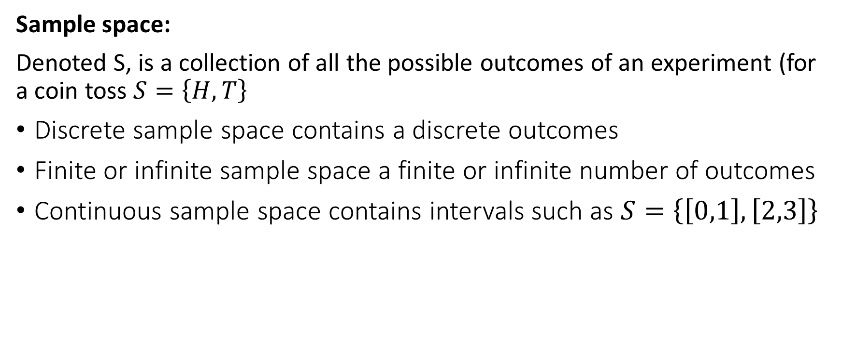
BASIC DEFINITIONS
Sample space:
Denoted S, is a collection of all the possible outcomes of an experiment (for a coin toss $S=\left\{H,T\right\}$
Discrete sample space contains a discrete outcomes
Finite or infinite sample space a finite or infinite number of outcomes
Continuous sample space contains intervals such as $S=\left\{\left[0,1\right],\left[2,3\right]\right\}$

Slide 9
BASIC DEFINITIONS
Probability theory:
The study of the mathematical rules that govern random events
Statistics:
The application of probability theory to the collection, analysis, and description of random data for the purpose of making inferences, judgements or conclusions about a population

Slide 10
BASIC DEFINITIONS
Population: a collection of all objects or elements under study
Sample: a subset of a population selected for studying or testing

Slide 11
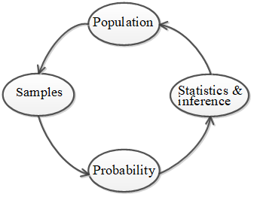
Relationship between Probability Theory and Statistics

Slide 12
Set Theory and Probability Theory
Set theory is the algebra of probability theory. It provides a basic mathematical tool for studying probability. The table below shows some correspondence of set algebra and probability theory.
Set Algebra | Probability Theory
Set | Event
Universal set | Sample space
Element | Outcome

Slide 13
Definitions
Set: An unordered collection of events (or objects or elements). Sets can contain items of mixed types or other sets. Sets are denoted by upper case letters
Universal set: Same as sample space and denoted S, contains all possible events or outcomes of an experiment
Empty set or null set: This is the impossible event and is denoted

Slide 14
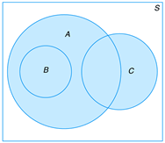
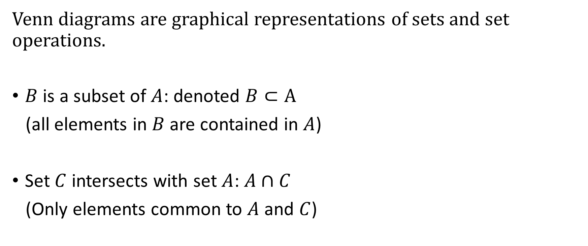
Venn Diagrams
Venn diagrams are graphical representations of sets and set operations.
$B$ is a subset of $A$: denoted $B⊂A$
(all elements in $B$ are contained in $A$)
Set $C$ intersects with set $A$: $A∩C$
(Only elements common to $A$ and $C$)

Slide 15
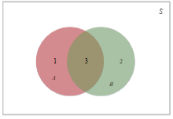
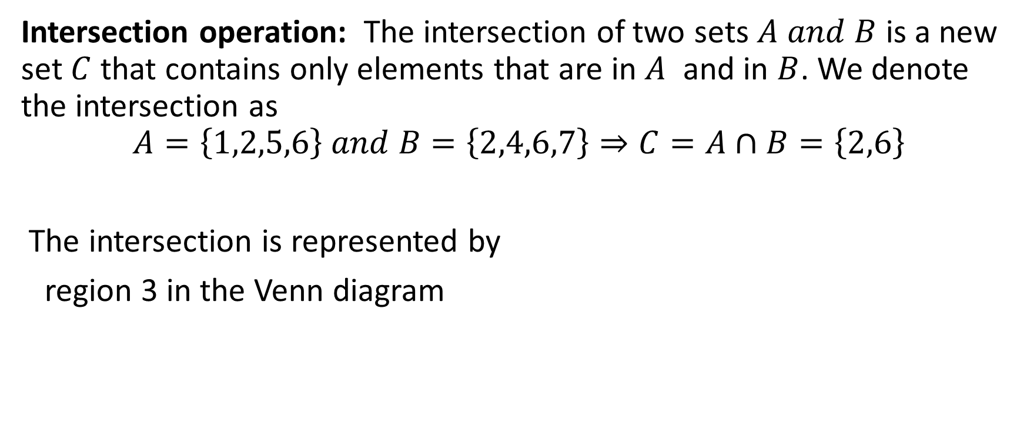
Basic Set Operations and Venn Diagrams
Intersection operation: The intersection of two sets $A and B$ is a new set $C$ that contains only elements that are in $A$ and in $B$. We denote the intersection as
$$A=\left\{1,2,5,6\right\} and B=\left\{2,4,6,7\right\}⇒C=A∩B=\left\{2,6\right\}$$
The intersection is represented by
region 3 in the Venn diagram

Slide 16
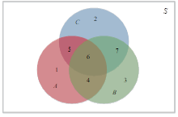
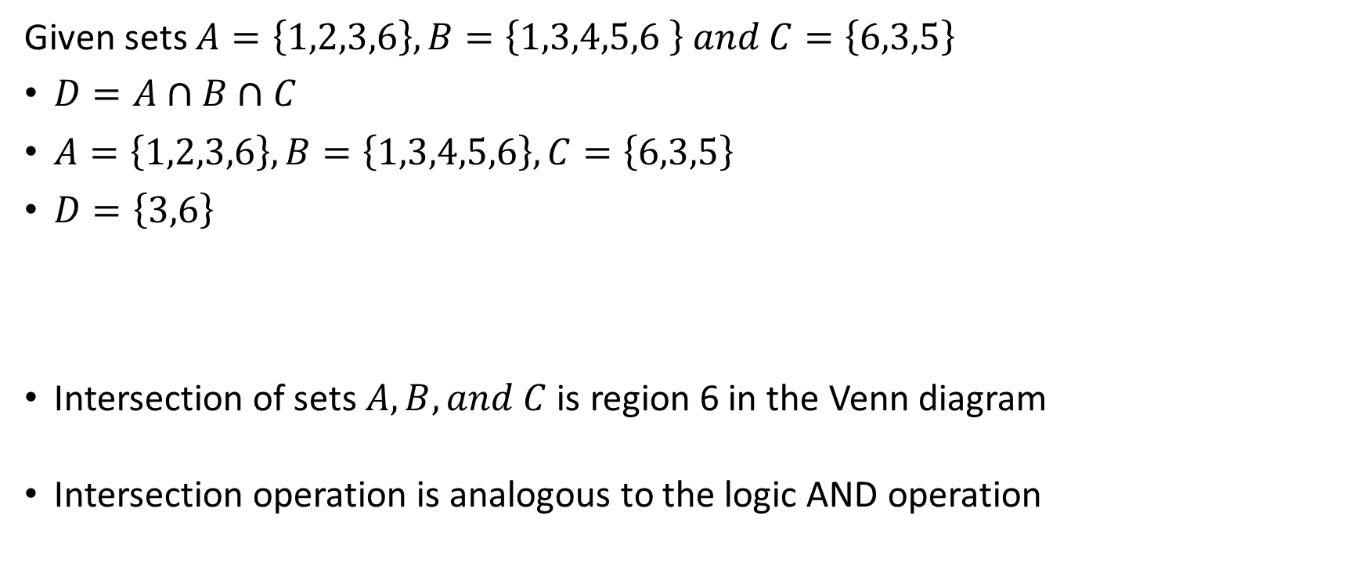
Intersection Operation
Given sets $A=\left\{1,2,3,6\right\}, B=\left\{1,3,4,5,6 \right\} and C=\left\{6,3,5\right\}$
$D=A∩B∩C$
$A=\left\{1,2,3,6\right\}, B=\left\{1,3,4,5,6\right\}, C=\left\{6,3,5\right\}$
$D=\left\{3,6\right\}$
Intersection of sets $A, B, and C$ is region 6 in the Venn diagram
Intersection operation is analogous to the logic AND operation

Slide 17
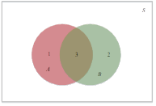
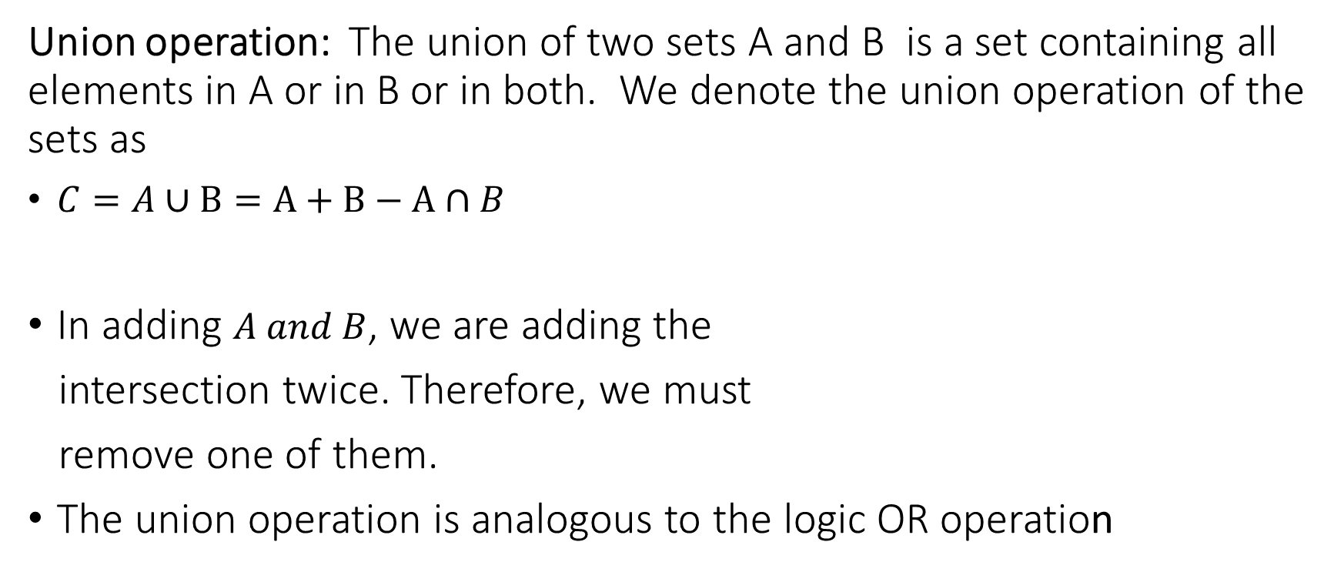
The Union Operation
Union operation: The union of two sets A and B is a set containing all elements in A or in B or in both. We denote the union operation of the sets as
$C=A∪B=A+B−A∩B$
In adding $A and B$, we are adding the
intersection twice. Therefore, we must
remove one of them.
The union operation is analogous to the logic OR operation

Slide 18
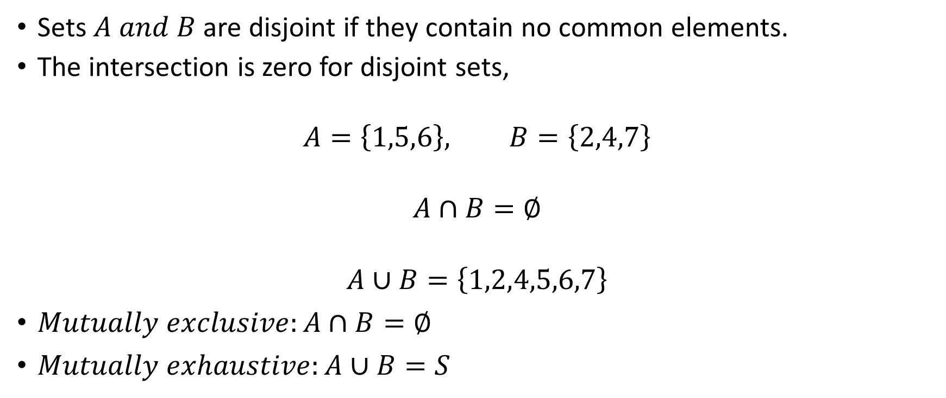
Intersection and Union Operations for Disjoint Sets
Sets $A and B$ are disjoint if they contain no common elements.
The intersection is zero for disjoint sets,
$$A=\left\{1,5,6\right\}, B=\left\{2,4,7\right\}$$
$$A∩B=∅$$
$$A∪B=\left\{1,2,4,5,6,7\right\}$$
$Mutually exclusive:A∩B=∅$
$Mutually exhaustive:A∪B=S$

Slide 19
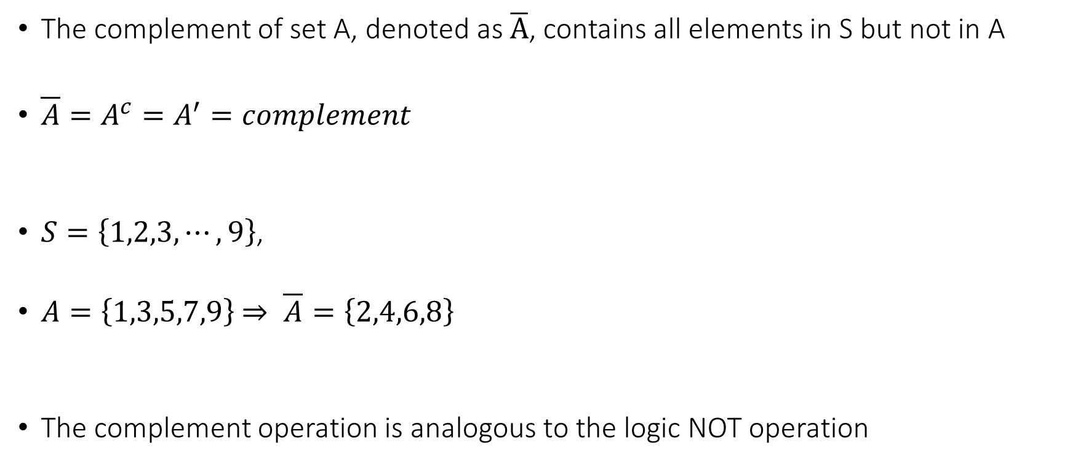
The Complement Operation
The complement of set A, denoted as $\overline{A}$, contains all elements in S but not in A
$\overline{A}=A^{c}=A^{′}=complement$
$S=\left\{1,2,3,⋯,9\right\}$,
$A=\left\{1,3,5,7,9\right\}$ $⇒ \overline{A}=\left\{2,4,6,8\right\}$
The complement operation is analogous to the logic NOT operation

Slide 20
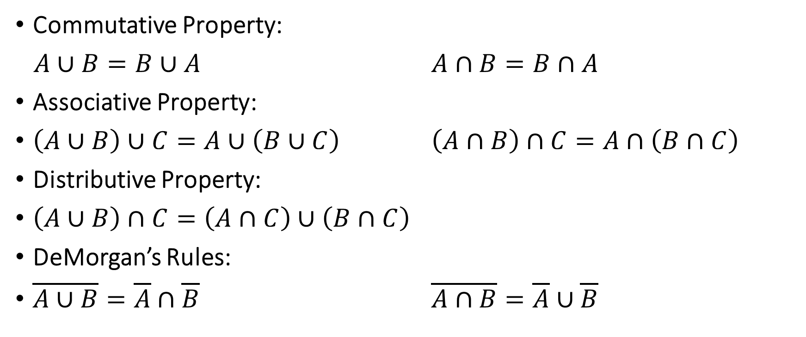
Basic Set Identities
Commutative Property:
$A∪B=B∪A$ $A∩B=B∩A$
Associative Property:
$\left(A∪B\right)∪C=A∪\left(B∪C\right)$ $\left(A∩B\right)∩C=A∩\left(B∩C\right)$
Distributive Property:
$\left(A∪B\right)∩C=\left(A∩C\right)∪\left(B∩C\right)$
DeMorgan’s Rules:
$\overline{A∪B}=\overline{A}∩\overline{B}$ $\overline{A∩B}=\overline{A}∪\overline{B}$

Slide 21
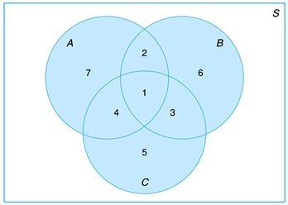
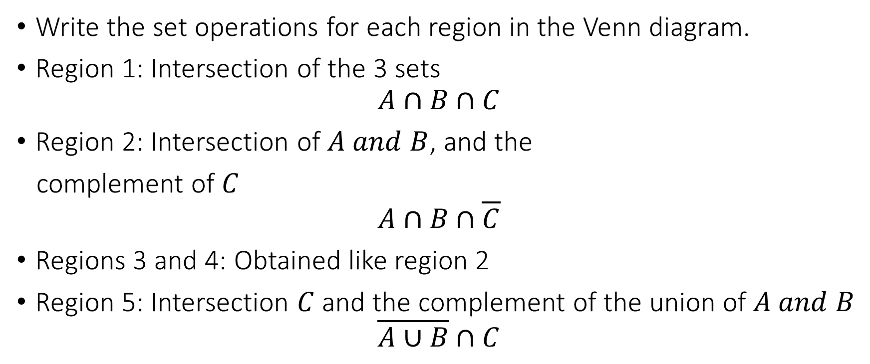
Examples
Write the set operations for each region in the Venn diagram.
Region 1: Intersection of the 3 sets
$$A∩B∩C$$
Region 2: Intersection of $A and B$, and the
complement of $C$
$$A∩B∩\overline{C}$$
Regions 3 and 4: Obtained like region 2
Region 5: Intersection $C$ and the complement of the union of $A and B$
$$\overline{A∪B}∩C$$

Slide 22
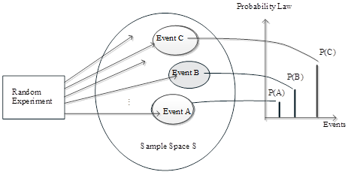

Probability Model
Conduct a random experiment, then define the events (group of outcomes). Next, assign a probability of occurrence, denoted $P\left[.\right]$, for each event.

Slide 23
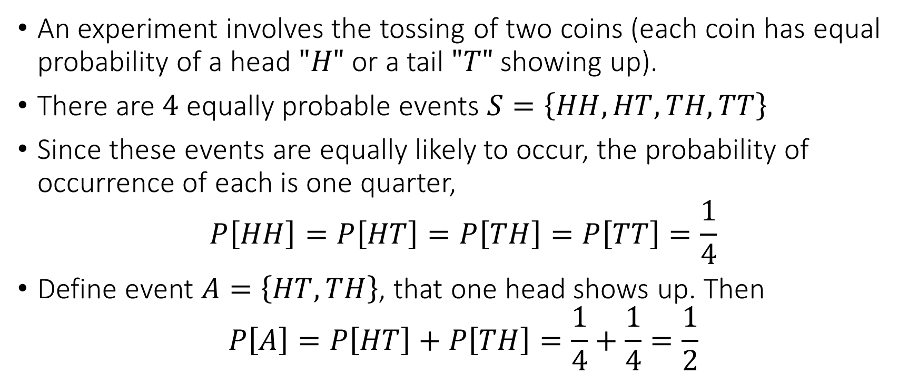
Examples
An experiment involves the tossing of two coins (each coin has equal probability of a head $"H"$ or a tail $"T"$ showing up).
There are $4$ equally probable events $S=\left\{HH,HT,TH,TT\right\}$
Since these events are equally likely to occur, the probability of occurrence of each is one quarter,
$$P\left[HH\right]=P\left[HT\right]=P\left[TH\right]=P\left[TT\right]=\frac{1}{4}$$
Define event $A=\left\{HT,TH\right\}$, that one head shows up. Then
$$P\left[A\right]=P\left[HT\right]+P\left[TH\right]=\frac{1}{4}+\frac{1}{4}=\frac{1}{2}$$

Slide 24
Probability Axioms and Corollaries
To be able to handle probabilities, we need to know the properties of probability and how to assign probabilities. Probability axioms provide us the properties. Corollaries are properties that are derived from the axioms

Slide 25
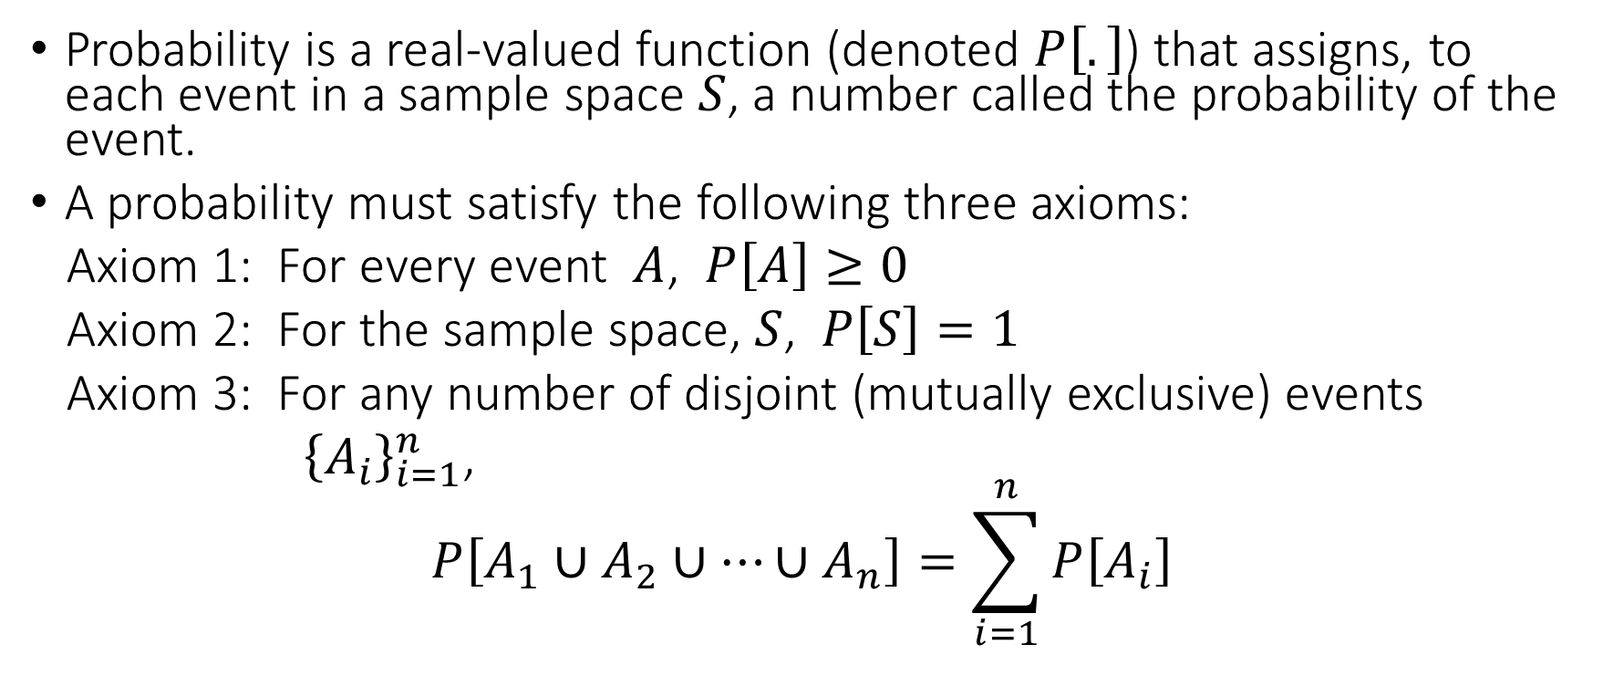
Probability Axioms
Probability is a real-valued function (denoted $P\left[.\right]$) that assigns, to each event in a sample space $S$, a number called the probability of the event.
A probability must satisfy the following three axioms:
Axiom 1: For every event $A$, $P\left[A\right]≥0$
Axiom 2: For the sample space, $S$, $P\left[S\right]=1$
Axiom 3: For any number of disjoint (mutually exclusive) events
${\left\{A_{i}\right\}}_{i=1}^{n}$,
$$P\left[A_{1}∪A_{2}∪⋯∪A_{n}\right]=\sum_{i=1}^{n}{P\left[A_{i}\right]}$$

Slide 26
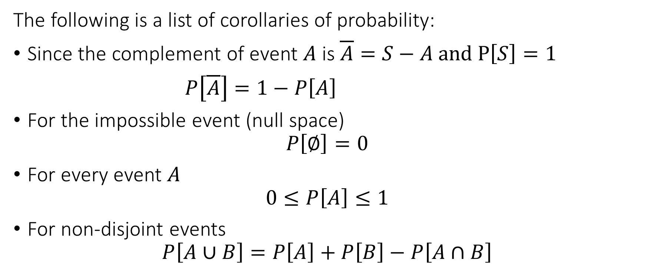
Corollaries of Probability Axioms
The following is a list of corollaries of probability:
Since the complement of event $A$ is $\overline{A}=S−A and P\left[S\right]=1$
$P\left[\overline{A}\right]=1−P\left[A\right]$
For the impossible event (null space)
$$P\left[∅\right]=0$$
For every event $A$
$$0≤P\left[A\right]≤1$$
For non-disjoint events
$$P\left[A∪B\right]=P\left[A\right]+P\left[B\right]−P\left[A∩B\right]$$

Slide 27
Methods of Assigning Probabilities
Subjective approach:
Judgement based on degree of belief of occurrence of an event
- horse race and stock price, etc.
Disadvantage: Non-engineering/Scientific

Slide 28
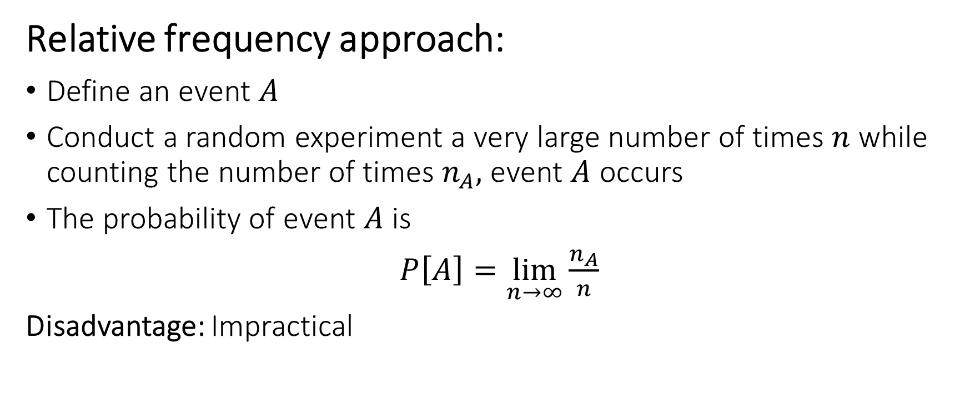
Methods of Assigning Probabilities
Relative frequency approach:
Define an event $A$
Conduct a random experiment a very large number of times $n$ while counting the number of times $n_{A},$ event $A$ occurs
The probability of event $A$ is
$P\left[A\right]=\lim_{n→∞}{\frac{n_{A}}{n}}$
Disadvantage: Impractical

Slide 29
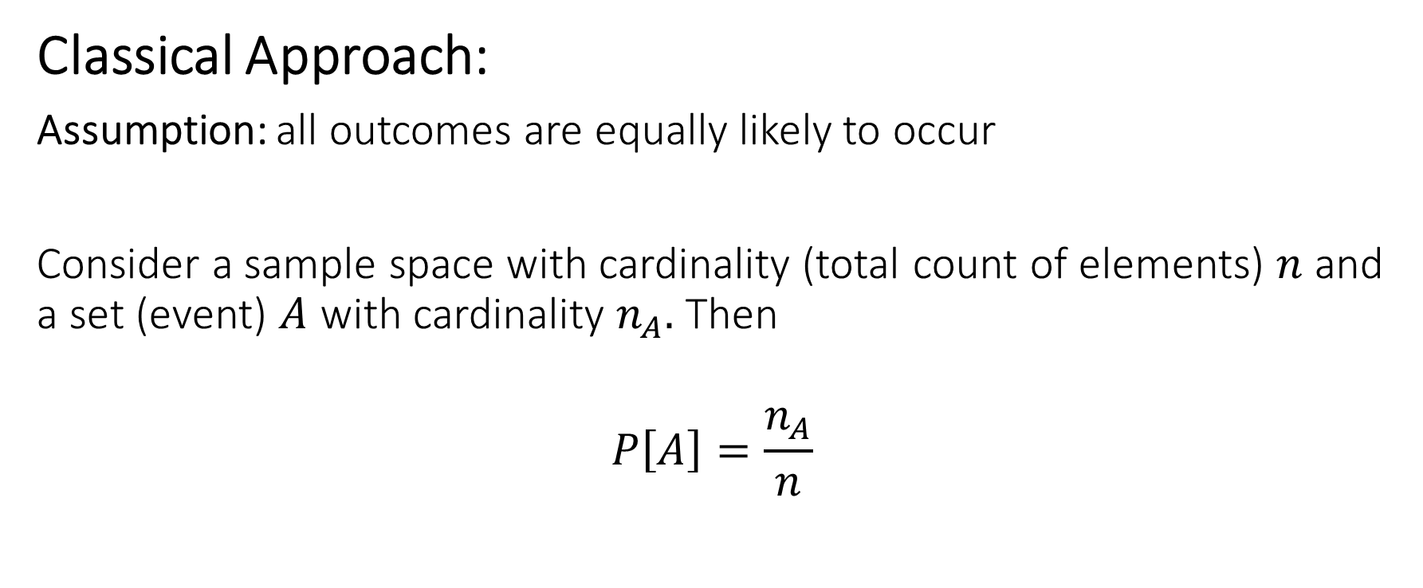
Methods of Assigning Probabilities
Classical Approach:
Assumption: all outcomes are equally likely to occur
Consider a sample space with cardinality (total count of elements) $n$ and a set (event) $A$ with cardinality $n_{A}.$ Then
$$P\left[A\right]=\frac{n_{A}}{n}$$

Slide 30
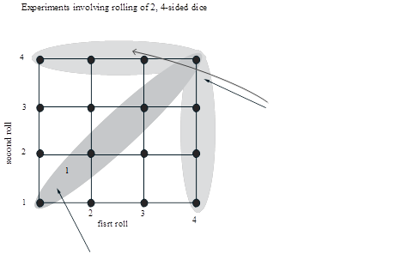
Classical Approach – Example 1

Slide 31
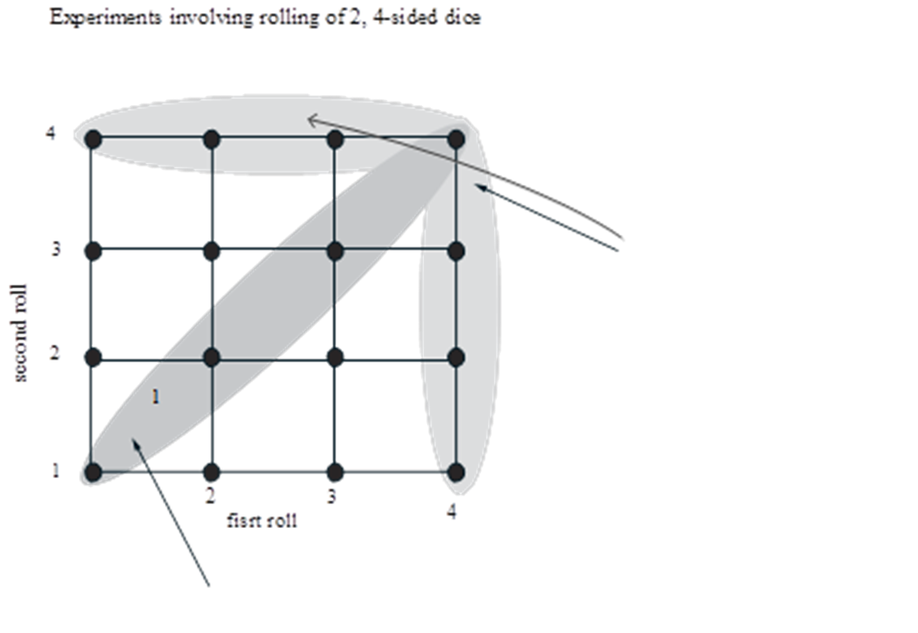
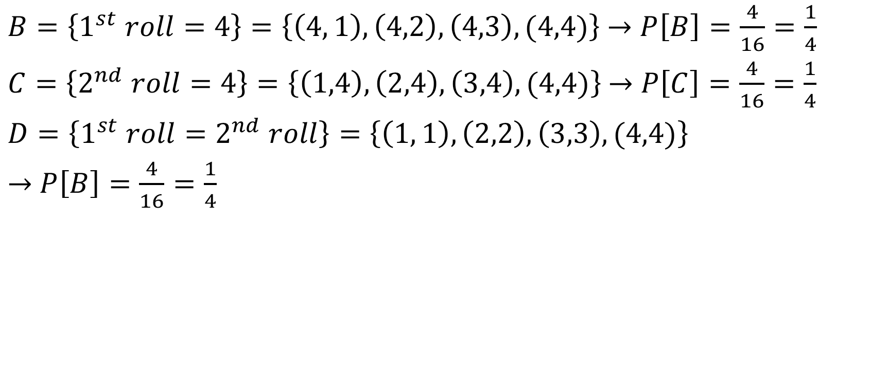
Classical Approach – Example 1
$B=\left\{1^{st} roll=4\right\}=\left\{\left(4, 1\right),\left(4,2\right), \left(4,3\right), (4,4)\right\}$ $→$ $P\left[B\right]=\frac{4}{16}=\frac{1}{4}$
$C=\left\{2^{nd} roll=4\right\}=\left\{\left(1,4\right),\left(2,4\right), \left(3,4\right), (4,4)\right\}$ $→$ $P\left[C\right]=\frac{4}{16}=\frac{1}{4}$
$D=\left\{1^{st} roll=2^{nd} roll\right\}=\left\{\left(1, 1\right),\left(2,2\right), \left(3,3\right), (4,4)\right\}$
$→$ $P\left[B\right]=\frac{4}{16}=\frac{1}{4}$

Slide 32
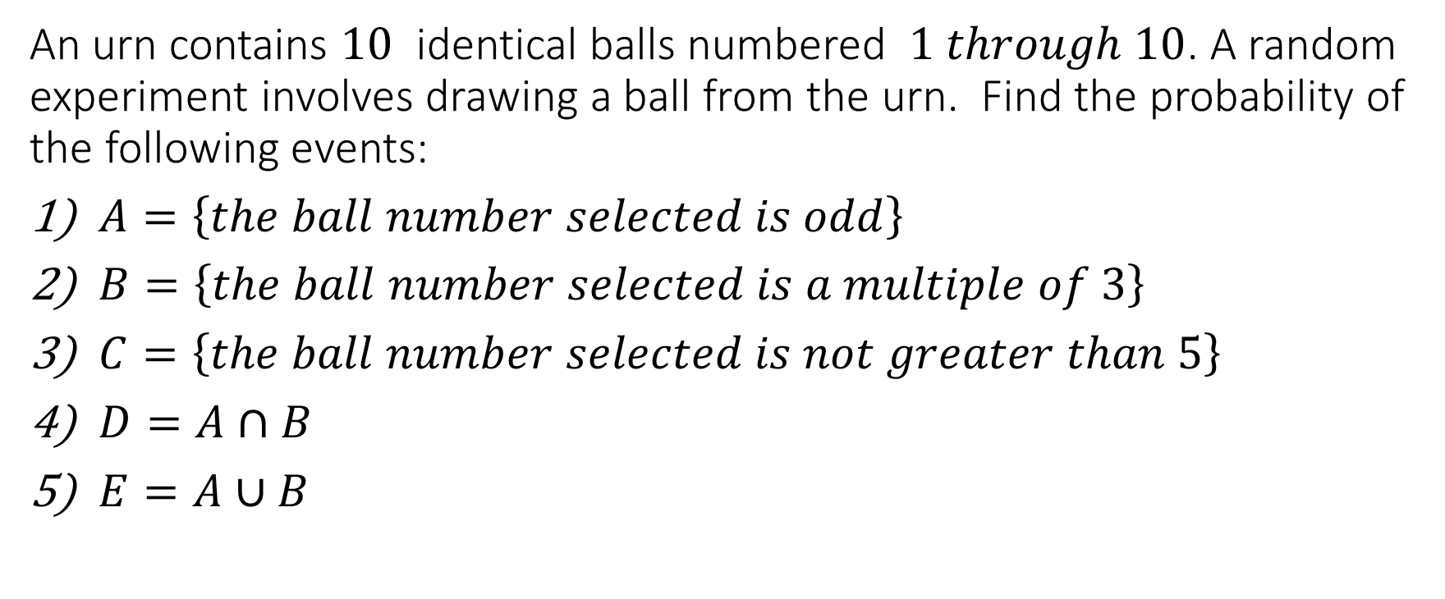
Classical Approach – Example 2
An urn contains $10$ identical balls numbered $1 through 10$. A random experiment involves drawing a ball from the urn. Find the probability of the following events:
$A=\left\{the ball number selected is odd\right\}$
$B=\left\{the ball number selected is a multiple of 3\right\}$
$C=\left\{the ball number selected is not greater than 5\right\}$
$D=A∩B$
$E=A∪B$

Slide 33
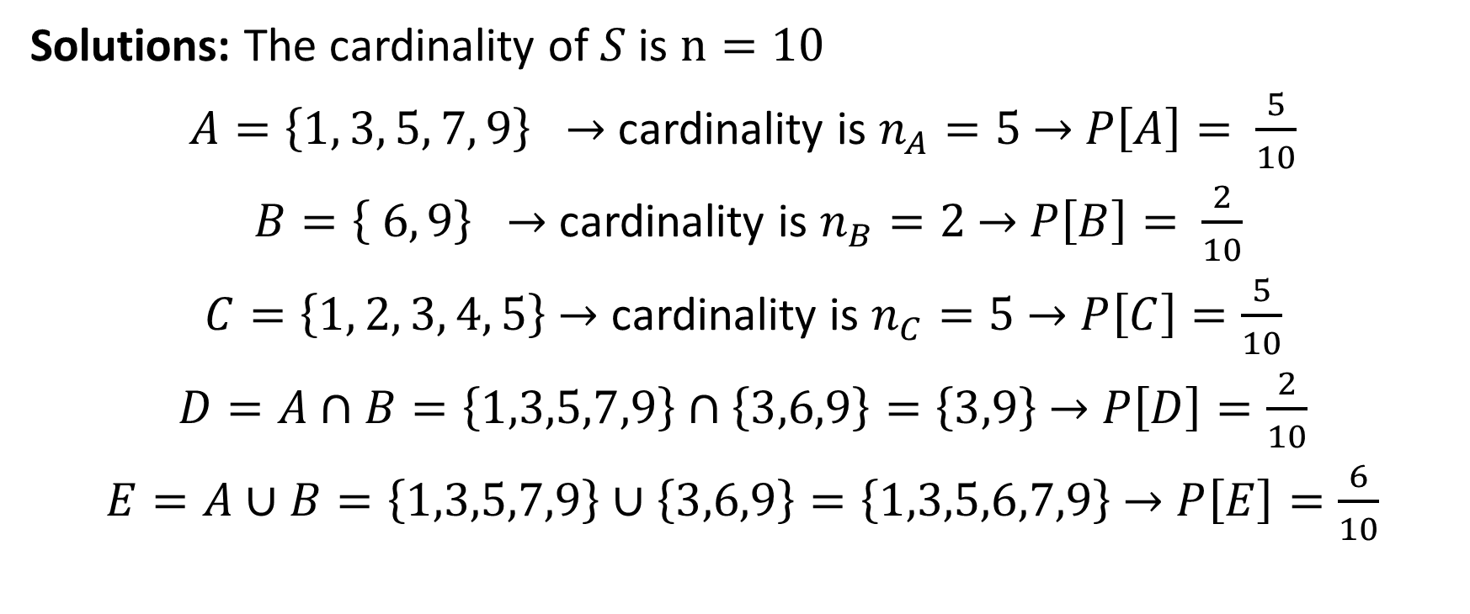
Classical Approach – Example 2
Solutions: The cardinality of $S$ is $n=10$
$A=\left\{1, 3, 5, 7, 9\right\}$ $→$ cardinality is $n_{A}=5$ $→$ $P\left[A\right]=$ $\frac{5}{10}$
$B=\left\{ 6, 9\right\}$ $→$ cardinality is $n_{B}=2$ $→$ $P\left[B\right]=$ $\frac{2}{10}$
$C=\left\{1, 2, 3, 4, 5\right\}$ $→$ cardinality is $n_{C}=5$ $→$ $P\left[C\right]=\frac{5}{10}$
$D=A∩B=\left\{1,3,5,7,9\right\}∩\left\{3,6,9\right\}=\left\{3,9\right\}$ $→$ $P\left[D\right]=\frac{2}{10}$
$E=A∪B=\left\{1,3,5,7,9\right\}∪\left\{3,6,9\right\}=\left\{1,3,5,6,7,9\right\}$ $→$ $P\left[E\right]=\frac{6}{10}$

Slide 34
Classical Approach – Example 3
Definitions:
A coin is fair if heads and tails have equal chances of showing up.
A coin is biased if one side has a better chance of showing up.
A die is fair if all the sides have equal chances of showing up.
A die is biased if some sides have a better chance of showing up
A fair coin is tossed 3 times. Find the probability of exactly two heads showing up in three tosses.

Slide 35
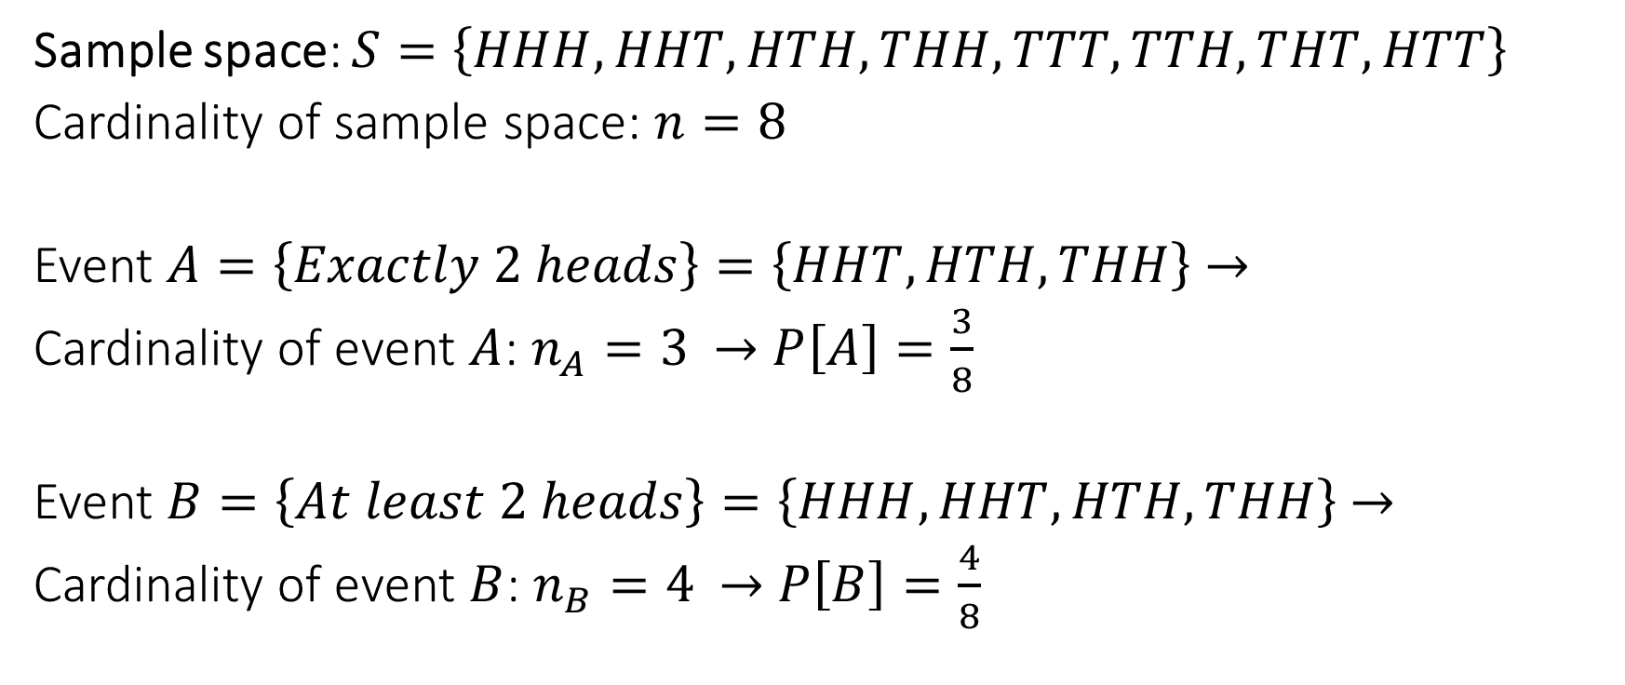
Classical Approach – Example 3
Sample space: $S=\left\{HHH, HHT, HTH, THH, TTT, TTH, THT, HTT\right\}$
Cardinality of sample space: $n=8$
Event $A=\left\{Exactly 2 heads\right\}=\left\{HHT, HTH, THH\right\}$ $→$
Cardinality of event $A$: $n_{A}=3$ $→$ $P\left[A\right]=\frac{3}{8}$
Event $B=\left\{At least 2 heads\right\}=\left\{HHH, HHT, HTH, THH\right\}$ $→$
Cardinality of event $B$: $n_{B}=4$ $→$ $P\left[B\right]=\frac{4}{8}$

